Slide 1
IBM APPLIED DATA SCIENCE CAPSTONE
Data Science Capstone Project Report
Predicting whether the SpaceX Falcon 9 first stage will land
Author: khoalee252006
Date: October 23, 2026
GitHub: https://github.com/khoalee252006/spacex-falcon9-capstone
Notes:
Hello everyone. — Xin chào mọi người.
My project is about SpaceX Falcon 9 rockets. — Dự án của tôi nói về tên lửa SpaceX Falcon 9.
I want to predict if the first stage will land. — Tôi muốn dự đoán tầng một có hạ cánh được không.
All my code is on GitHub. — Toàn bộ code của tôi có trên GitHub.

Slide 2
Project GitHub Repository
Repository: https://github.com/khoalee252006/spacex-falcon9-capstone
1
Data Collection – SpaceX API
https://github.com/khoalee252006/spacex-falcon9-capstone/blob/main/notebooks/01_data_collection_api.ipynb
2
Data Collection – Web Scraping
https://github.com/khoalee252006/spacex-falcon9-capstone/blob/main/notebooks/02_data_collection_webscraping.ipynb
3
Data Wrangling
https://github.com/khoalee252006/spacex-falcon9-capstone/blob/main/notebooks/03_data_wrangling.ipynb
4
EDA with Data Visualization
https://github.com/khoalee252006/spacex-falcon9-capstone/blob/main/notebooks/04_eda_visualization.ipynb
5
EDA with SQL
https://github.com/khoalee252006/spacex-falcon9-capstone/blob/main/notebooks/05_eda_sql.ipynb
6
Interactive Map with Folium
https://github.com/khoalee252006/spacex-falcon9-capstone/blob/main/notebooks/06_interactive_folium_map.ipynb
7
Plotly Dash Dashboard
https://github.com/khoalee252006/spacex-falcon9-capstone/blob/main/notebooks/07_dash_app.py
8
Predictive Analysis
https://github.com/khoalee252006/spacex-falcon9-capstone/blob/main/notebooks/08_predictive_analysis.ipynb
GitHub: https://github.com/khoalee252006/spacex-falcon9-capstone
2
Notes:
This slide shows my GitHub repository. — Slide này cho thấy kho GitHub của tôi.
Each step has its own notebook. — Mỗi bước có một notebook riêng.
You can click the links to see the code. — Bạn có thể bấm vào link để xem code.

Slide 3
Outline
01
Executive Summary
06
Results: Launch Sites Proximity (Folium)
02
Introduction
07
Results: Dashboard (Plotly Dash)
03
Methodology
08
Results: Predictive Analysis
04
Results: EDA with Visualization
09
Conclusion
05
Results: EDA with SQL
10
Appendix
GitHub: https://github.com/khoalee252006/spacex-falcon9-capstone
3
Notes:
This is the plan of my talk. — Đây là kế hoạch bài trình bày của tôi.
First, the summary and the problem. — Đầu tiên là tóm tắt và vấn đề.
Then methods, results, and conclusion. — Sau đó là phương pháp, kết quả và kết luận.

Slide 4
Executive Summary
Methods
• Data collection: SpaceX REST API + web scraping (Wikipedia)
• Data wrangling: missing values, landing label Class (1 / 0), one-hot encoding
• EDA: pandas, matplotlib / seaborn charts and SQL (SQLite)
• Interactive analytics: Folium map and Plotly Dash dashboard
• Machine learning: Logistic Regression, SVM, Decision Tree, KNN with GridSearchCV (cv = 10)
Key results
• 90 Falcon 9 launches (2010–2020); 60 landed = 66.7% success
• Success grew from 0% (2010–2013) to 90% in 2019
• Best common orbit: VLEO 86%; weakest: GTO 52%
• When a landing was attempted, 87.0% succeeded
• Logistic Regression, SVM, KNN: 83.3% test accuracy (tie); SVM has the best validation accuracy (84.8%)
GitHub: https://github.com/khoalee252006/spacex-falcon9-capstone
4
Notes:
I collected real launch data from an API and Wikipedia. — Tôi thu thập dữ liệu phóng thật từ API và Wikipedia.
Overall, 66.7% of first stages landed. — Nhìn chung, 66.7% tầng một đã hạ cánh.
Landing success grew a lot over the years. — Tỉ lệ hạ cánh thành công tăng rất nhiều qua các năm.
My best models reach 83.3% test accuracy. — Các mô hình tốt nhất đạt độ chính xác 83.3% trên tập kiểm tra.

Slide 5
Introduction
Background
• SpaceX advertises Falcon 9 launches at about $62 million.
• Other providers charge $165 million or more per launch.
• Most of the saving comes from landing and reusing the first stage.
• A new company ("Space Y") wants to bid against SpaceX.
Problem statement
• Can we predict if the Falcon 9 first stage will land successfully?
• If yes, we can estimate the real cost of a launch.
Questions we answer
• How do payload mass, orbit, launch site and flight number affect landing?
• Did landing success improve over time?
• Where are the launch sites, and why there?
• Which machine-learning model predicts landing best?
GitHub: https://github.com/khoalee252006/spacex-falcon9-capstone
5
Notes:
SpaceX rockets cost about 62 million dollars. — Tên lửa SpaceX có giá khoảng 62 triệu đô la.
Other companies cost 165 million dollars or more. — Các công ty khác tốn 165 triệu đô la trở lên.
The big saving comes from reusing the first stage. — Khoản tiết kiệm lớn đến từ việc tái sử dụng tầng một.
So we predict if the first stage will land. — Vì vậy chúng tôi dự đoán tầng một có hạ cánh không.

Slide 6
METHODOLOGY
Data Collection – SpaceX API
GET /v4/launches/past
json_normalize → DataFrame
Look up rockets, launchpads, payloads, cores
Keep Falcon 9 (1 core, 1 payload, ≤ 13 Nov 2020)
Save CSV
(90 rows × 17 columns)
Key phrases
• requests.get() → JSON response
• pd.json_normalize() to flatten the JSON
• Helper look-ups: BoosterVersion, LaunchSite, PayloadMass, Orbit, Outcome, Block, Serial…
• Missing PayloadMass (5) → filled with mean (6,123.55 kg)
Note on data source
• The live API returned HTTP 522/525 errors (server down) in Oct 2026.
• The code tries the live API first, then falls back to saved copies of the same API responses: IBM's static launch JSON + archived responses (web.archive.org).
• Check: 15 of 17 columns are identical to IBM's reference dataset_part_1.csv.
GitHub: https://github.com/khoalee252006/spacex-falcon9-capstone/blob/main/notebooks/01_data_collection_api.ipynb
6
Notes:
I call the SpaceX API to get past launches. — Tôi gọi SpaceX API để lấy các lần phóng trước đây.
Then I look up rocket, pad, payload and core details. — Sau đó tôi tra thông tin tên lửa, bệ phóng, tải trọng và lõi.
I keep only Falcon 9 and save a clean table. — Tôi chỉ giữ Falcon 9 và lưu một bảng sạch.

Slide 7
METHODOLOGY
Data Collection – Web Scraping
requests.get() Wikipedia page (oldid = 1027686922)
BeautifulSoup(html)
find_all tables "wikitable plainrowheaders collapsible"
Read column names + each launch row
DataFrame → save CSV
(121 rows)
Key phrases
• Page: "List of Falcon 9 and Falcon Heavy launches" – fixed old revision used by the IBM lab (June 2021), so results repeat
• 9 launch tables found; flight number is in the <th> cell, other values in <td> cells
• Columns: Flight No., Date, Time, Version Booster, Launch site, Payload, Payload mass, Orbit, Customer, Launch outcome, Booster landing
• Cleaning: remove footnote marks like [12], parse "4,700 kg" → 4700, parse dates
• Result: 121 launches from 04 Jun 2010 to 06 Jun 2021
GitHub: https://github.com/khoalee252006/spacex-falcon9-capstone/blob/main/notebooks/02_data_collection_webscraping.ipynb
7
Notes:
I download a Wikipedia page with launch tables. — Tôi tải một trang Wikipedia có các bảng phóng.
BeautifulSoup reads the HTML tables. — BeautifulSoup đọc các bảng HTML.
I get 121 launch rows and save them to CSV. — Tôi lấy được 121 dòng và lưu vào CSV.

Slide 8
METHODOLOGY
Data Wrangling
Load dataset_part_1.csv
Missing values
Count launches per site / orbit / outcome
Outcome → Class (1 / 0)
One-hot encode features
• PayloadMass: 5 missing → replaced by mean
• LandingPad: 26 missing (28.9%) → kept, means "no landing pad used"
• Good outcomes (Class = 1): True ASDS (drone ship), True RTLS (ground pad), True Ocean
• Bad outcomes (Class = 0): False ASDS / RTLS / Ocean, None ASDS, None None
• Success rate = mean(Class) = 66.7%
• Output: dataset_part_2.csv (+ Class) and dataset_part_3.csv (80 numeric features)
Outcome | Launches | Class
True ASDS | 41 | 1
None None | 19 | 0
True RTLS | 14 | 1
False ASDS | 6 | 0
True Ocean | 5 | 1
False Ocean | 2 | 0
None ASDS | 2 | 0
False RTLS | 1 | 0
GitHub: https://github.com/khoalee252006/spacex-falcon9-capstone/blob/main/notebooks/03_data_wrangling.ipynb
8
Notes:
I check missing values first. — Đầu tiên tôi kiểm tra giá trị bị thiếu.
Then I turn the landing outcome into a label called Class. — Sau đó tôi biến kết quả hạ cánh thành nhãn tên là Class.
Class is 1 if the booster landed, and 0 if not. — Class bằng 1 nếu tầng đẩy hạ cánh, bằng 0 nếu không.
The overall success rate is 66.7%. — Tỉ lệ thành công tổng thể là 66.7%.

Slide 9
METHODOLOGY
EDA with Data Visualization
Chart type | Chart | Why we use it
Scatter | Flight Number vs. Payload Mass | Does experience or payload change landing?
Scatter | Flight Number vs. Launch Site | Do sites improve over time?
Scatter | Payload Mass vs. Launch Site | Which site handles heavy payloads?
Bar | Success Rate by Orbit | Which orbit is easiest to land from?
Scatter | Flight Number vs. Orbit | Does each orbit improve with flights?
Scatter | Payload Mass vs. Orbit | Is heavy payload a problem in some orbits?
Line | Yearly Success Trend | Is SpaceX getting better each year?
Points are colored by Class: green = landed, red = not landed. Tools: pandas, matplotlib, seaborn.
GitHub: https://github.com/khoalee252006/spacex-falcon9-capstone/blob/main/notebooks/04_eda_visualization.ipynb
9
Notes:
I use charts to find patterns. — Tôi dùng biểu đồ để tìm các quy luật.
Scatter plots show how two things relate. — Biểu đồ phân tán cho thấy hai yếu tố liên quan thế nào.
A bar chart compares orbits, and a line chart shows the trend by year. — Biểu đồ cột so sánh các quỹ đạo, biểu đồ đường cho thấy xu hướng theo năm.

Slide 10
METHODOLOGY
EDA with SQL
# | Question | Key SQL
1 | Unique launch sites | SELECT DISTINCT
2 | 5 records with site starting 'CCA' | LIKE 'CCA%' LIMIT 5
3 | Total payload for NASA (CRS) | SUM()
4 | Average payload of F9 v1.1 | AVG()
5 | First successful ground-pad landing | MIN(Date)
6 | Drone-ship success, payload 4000–6000 kg | AND, > <
7 | Count of mission successes / failures | COUNT(*) GROUP BY
8 | Boosters with maximum payload | subquery MAX()
9 | 2015 drone-ship failures by month | substr(Date)
10 | Rank landing outcomes 2010-06-04 → 2017-03-20 | BETWEEN, ORDER BY DESC
Data: IBM course table Spacex.csv (101 Falcon 9 launches) loaded into SQLite with pandas.to_sql().
GitHub: https://github.com/khoalee252006/spacex-falcon9-capstone/blob/main/notebooks/05_eda_sql.ipynb
10
Notes:
I load the launch table into SQLite. — Tôi nạp bảng phóng vào SQLite.
Then I answer ten questions with SQL. — Sau đó tôi trả lời mười câu hỏi bằng SQL.
I use DISTINCT, LIKE, SUM, AVG, MIN, GROUP BY and subqueries. — Tôi dùng DISTINCT, LIKE, SUM, AVG, MIN, GROUP BY và truy vấn con.

Slide 11
METHODOLOGY
Interactive Visual Analytics – Folium & Plotly Dash
Folium map
• folium.Circle + Marker: each launch site
• MarkerCluster: green = landed, red = not landed
• MousePosition: read coordinates on the map
• PolyLine + distance label: site → coast, railway, highway, city
• Nearest features found with OpenStreetMap (Overpass API) + haversine distance
Plotly Dash dashboard
• Dropdown: All sites or one launch site
• Pie chart: successful launches by site / success vs. failure
• RangeSlider: choose a payload range (kg)
• Scatter: payload vs. launch outcome, colored by booster version
• Callbacks update the charts when the user changes inputs
GitHub: https://github.com/khoalee252006/spacex-falcon9-capstone/blob/main/notebooks/06_interactive_folium_map.ipynb
GitHub: https://github.com/khoalee252006/spacex-falcon9-capstone/blob/main/notebooks/07_dash_app.py
SpaceX Falcon 9 – Data Science Capstone
11
Notes:
Folium puts every launch on a map. — Folium đặt mỗi lần phóng lên bản đồ.
Green markers mean landed, red markers mean not landed. — Điểm xanh là hạ cánh, điểm đỏ là không hạ cánh.
The Dash app lets users filter by site and payload. — Ứng dụng Dash cho phép lọc theo bãi phóng và tải trọng.

Slide 12
METHODOLOGY
Predictive Analysis – Methodology
X = 80 features
Y = Class
train_test_split
80 / 20, random_state = 2
(72 / 18)
StandardScaler
(fit on train)
GridSearchCV
cv = 10
4 models
Best params →
test accuracy +
confusion matrix
Model | Parameters searched
Logistic Regression | C = 0.01, 0.1, 1
SVM | kernel = linear / rbf / poly / sigmoid; C, gamma = logspace(-3, 3, 5)
Decision Tree | criterion, splitter, max_depth 2–18, max_features, min_samples_leaf / split
KNN | n_neighbors 1–10, algorithm, p = 1 / 2
Extra check: the test set has only 18 launches, so we also run 10-fold stratified cross-validation on all 90 launches.
GitHub: https://github.com/khoalee252006/spacex-falcon9-capstone/blob/main/notebooks/08_predictive_analysis.ipynb
12
Notes:
I split the data into training and test sets. — Tôi chia dữ liệu thành tập huấn luyện và tập kiểm tra.
I scale the features and tune four models. — Tôi chuẩn hoá đặc trưng và tinh chỉnh bốn mô hình.
GridSearchCV finds the best settings with ten folds. — GridSearchCV tìm thiết lập tốt nhất với mười phần.
Then I compare accuracy on the test set. — Sau đó tôi so sánh độ chính xác trên tập kiểm tra.

Slide 13
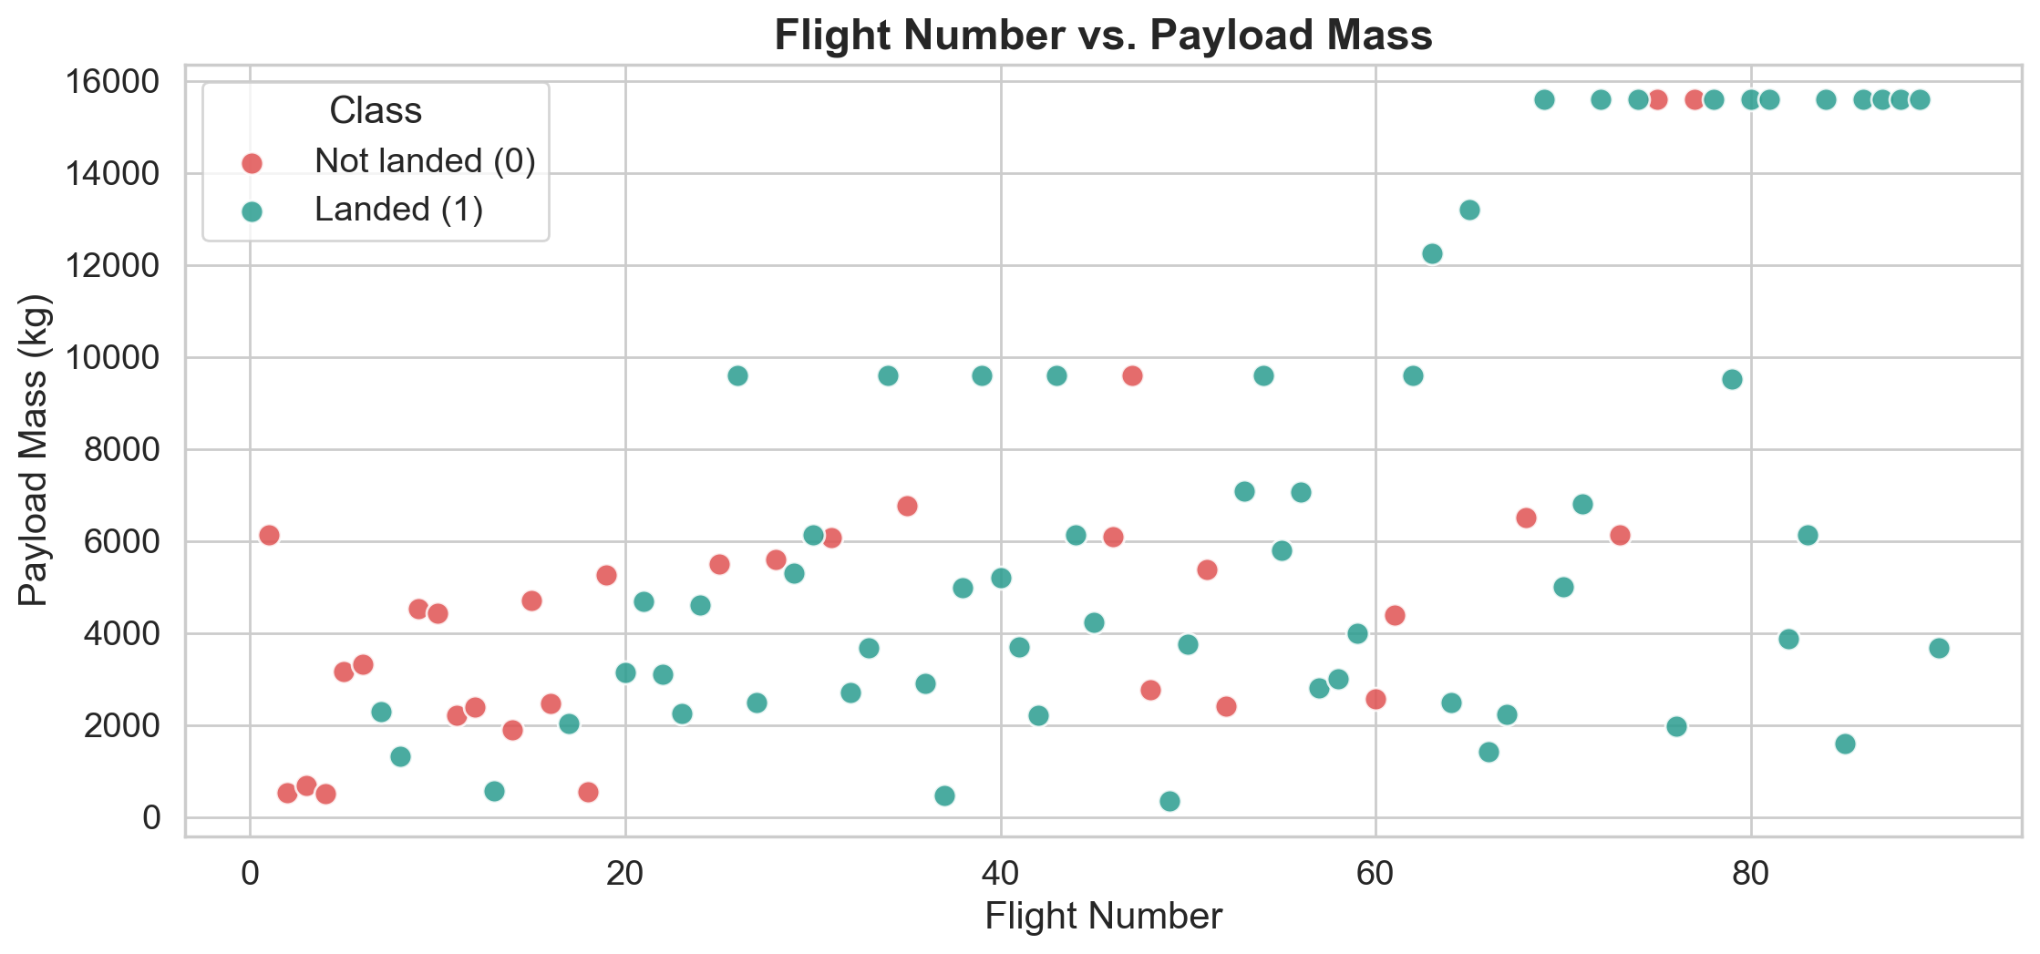
INSIGHTS DRAWN FROM EDA
Flight Number vs. Payload Mass
Insight: Later flights land more often (43% for flights 1–30 vs. 83% for flights 61–90). Heavy payloads (> 10,000 kg) still landed 13 of 15 times.
GitHub: https://github.com/khoalee252006/spacex-falcon9-capstone/blob/main/notebooks/04_eda_visualization.ipynb
13
Notes:
Each dot is one launch. — Mỗi chấm là một lần phóng.
Green dots appear more on the right side. — Chấm xanh xuất hiện nhiều hơn ở bên phải.
So SpaceX gets better with more flights. — Vậy SpaceX tiến bộ hơn khi bay nhiều hơn.

Slide 14
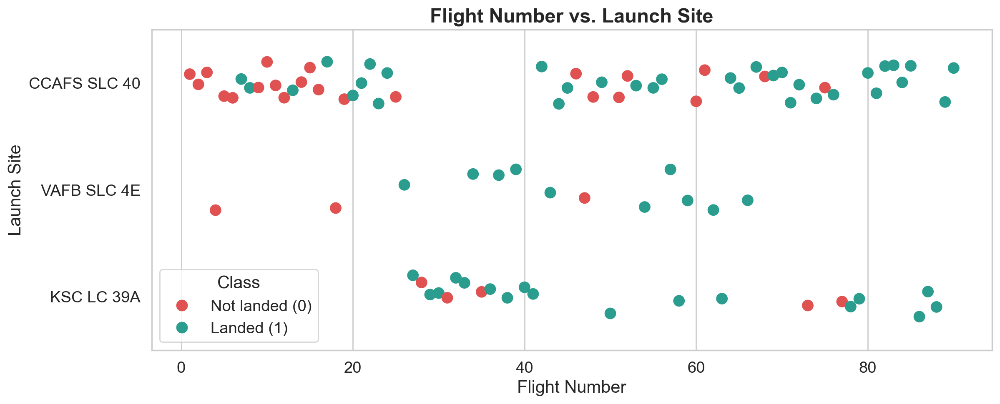
INSIGHTS DRAWN FROM EDA
Flight Number vs. Launch Site
Insight: CCAFS SLC 40 has the most launches (55) and the lowest rate (60%): its first 20 launches had 35% success, later ones 74%.
GitHub: https://github.com/khoalee252006/spacex-falcon9-capstone/blob/main/notebooks/04_eda_visualization.ipynb
14
Notes:
CCAFS SLC 40 is used the most. — CCAFS SLC 40 được dùng nhiều nhất.
Most early failures happened there. — Phần lớn thất bại ban đầu xảy ra ở đó.
Later launches there are much better. — Các lần phóng sau ở đó tốt hơn nhiều.

Slide 15
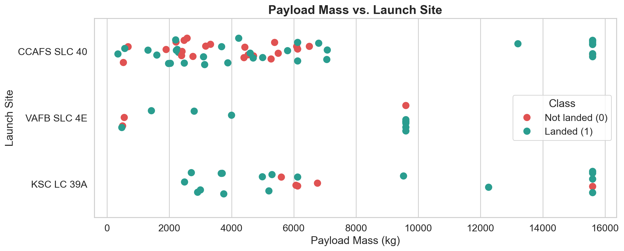
INSIGHTS DRAWN FROM EDA
Payload Mass vs. Launch Site
Insight: VAFB SLC 4E never launched more than 9,600 kg. All payloads above 10,000 kg flew from Florida, with high success.
GitHub: https://github.com/khoalee252006/spacex-falcon9-capstone/blob/main/notebooks/04_eda_visualization.ipynb
15
Notes:
Heavy payloads only fly from Florida. — Tải nặng chỉ phóng từ Florida.
Vandenberg launches lighter payloads. — Vandenberg phóng tải nhẹ hơn.
Heavy launches still land most of the time. — Các lần phóng nặng vẫn hạ cánh phần lớn.

Slide 16
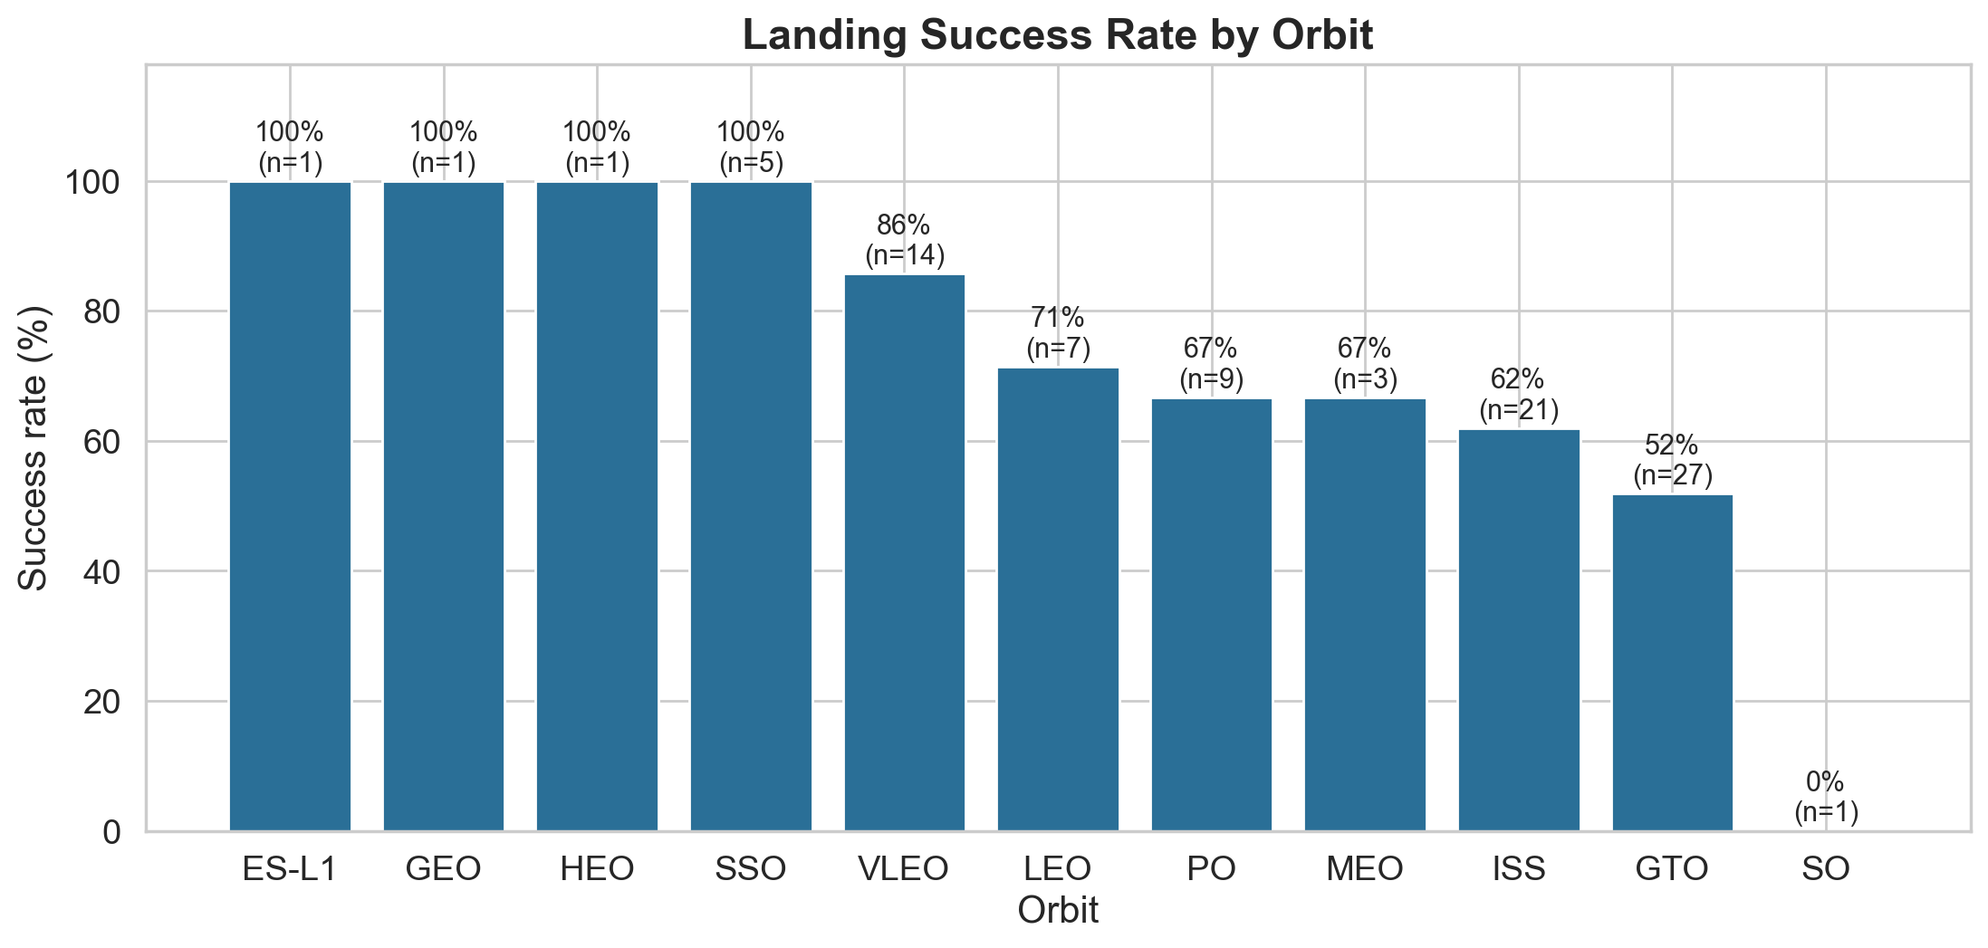
INSIGHTS DRAWN FROM EDA
Success Rate by Orbit Type
Insight: SSO, ES-L1, GEO and HEO show 100% but have very few launches. Among common orbits, VLEO is best (86%, n=14) and GTO is weakest (52%, n=27).
GitHub: https://github.com/khoalee252006/spacex-falcon9-capstone/blob/main/notebooks/04_eda_visualization.ipynb
16
Notes:
Each bar is one orbit type. — Mỗi cột là một loại quỹ đạo.
Some orbits have only one launch, so be careful. — Một số quỹ đạo chỉ có một lần phóng, nên cần cẩn thận.
VLEO is high and GTO is low. — VLEO cao còn GTO thấp.

Slide 17
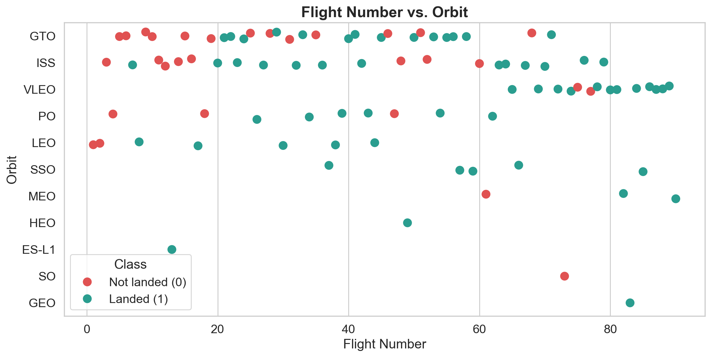
INSIGHTS DRAWN FROM EDA
Flight Number vs. Orbit
Insight: LEO failed only in the first two flights, then always landed. GTO shows no clear improvement (52%). VLEO flights all came late and landed 86%.
GitHub: https://github.com/khoalee252006/spacex-falcon9-capstone/blob/main/notebooks/04_eda_visualization.ipynb
17
Notes:
In LEO, success comes after a few flights. — Ở LEO, thành công đến sau vài lần bay.
In GTO, there is no clear pattern. — Ở GTO, không có quy luật rõ ràng.
VLEO launches started late and went well. — Các lần phóng VLEO bắt đầu muộn và diễn ra tốt.

Slide 18
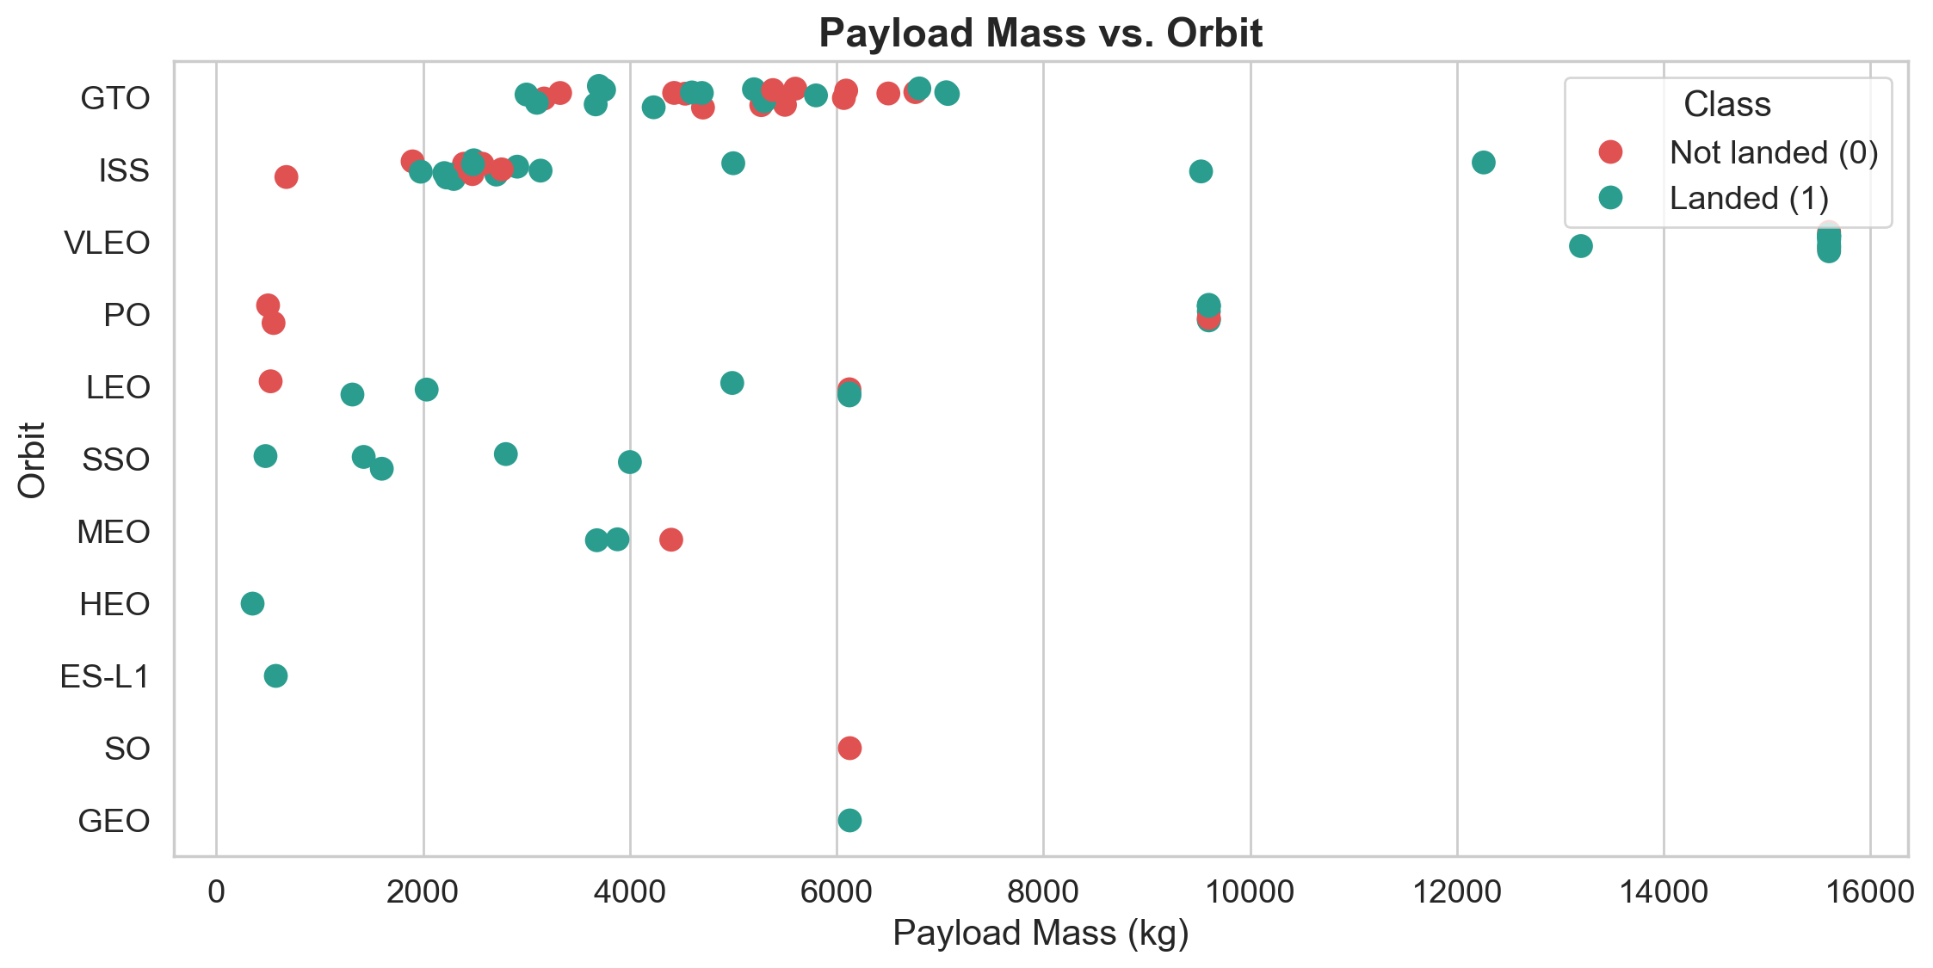
INSIGHTS DRAWN FROM EDA
Payload Mass vs. Orbit
Insight: Heavy VLEO payloads (13,200–15,600 kg) land well. In GTO, heavier payloads land less often (62% for ≤ 5,000 kg vs. 43% for > 5,000 kg).
GitHub: https://github.com/khoalee252006/spacex-falcon9-capstone/blob/main/notebooks/04_eda_visualization.ipynb
18
Notes:
Heavy payloads to VLEO are fine. — Tải nặng lên VLEO thì ổn.
Heavy payloads to GTO are harder. — Tải nặng lên GTO thì khó hơn.
GTO needs more fuel, so less is left for landing. — GTO cần nhiều nhiên liệu, nên còn ít để hạ cánh.

Slide 19
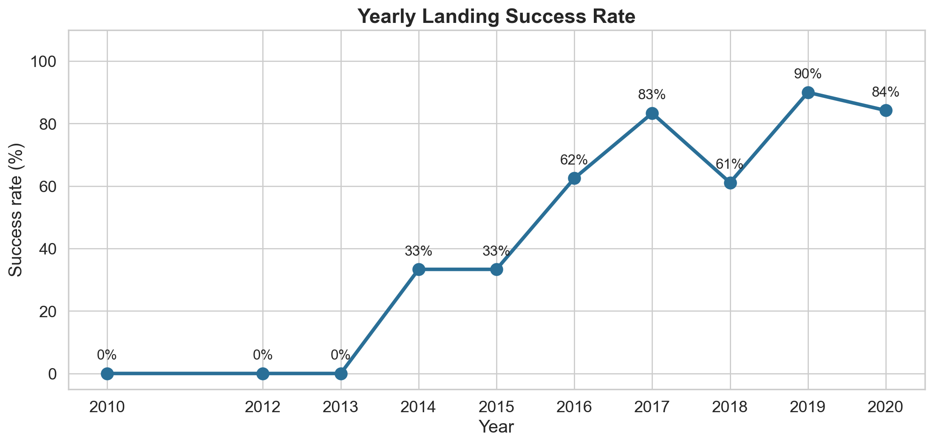
INSIGHTS DRAWN FROM EDA
Launch Success Yearly Trend
Insight: Success rose from 0% (2010–2013) to 90% in 2019 (84% in 2020), with one dip in 2018 (61%).
GitHub: https://github.com/khoalee252006/spacex-falcon9-capstone/blob/main/notebooks/04_eda_visualization.ipynb
19
Notes:
This line shows the success rate each year. — Đường này cho thấy tỉ lệ thành công mỗi năm.
It goes up strongly after 2013. — Nó tăng mạnh sau năm 2013.
SpaceX learned quickly. — SpaceX học hỏi rất nhanh.

Slide 20
EDA WITH SQL – RESULTS
SQL Results: Launch Sites
SELECT DISTINCT Launch_Site FROM SPACEXTABLE;
SELECT * FROM SPACEXTABLE
WHERE Launch_Site LIKE 'CCA%' LIMIT 5;
Launch_Site
CCAFS LC-40
VAFB SLC-4E
KSC LC-39A
CCAFS SLC-40
Date | Booster Version | Launch Site | Payload | PAYLOAD MASS KG | Orbit | Customer | Mission Outcome | Landing Outcome
2010-06-04 | F9 v1.0 B0003 | CCAFS LC-40 | Dragon Spacecraft Qualific | 0 | LEO | SpaceX | Success | Failure (parachute)
2010-12-08 | F9 v1.0 B0004 | CCAFS LC-40 | Dragon demo flight C1, two | 0 | LEO (ISS) | NASA (COTS) NRO | Success | Failure (parachute)
2012-05-22 | F9 v1.0 B0005 | CCAFS LC-40 | Dragon demo flight C2 | 525 | LEO (ISS) | NASA (COTS) | Success | No attempt
2012-10-08 | F9 v1.0 B0006 | CCAFS LC-40 | SpaceX CRS-1 | 500 | LEO (ISS) | NASA (CRS) | Success | No attempt
2013-03-01 | F9 v1.0 B0007 | CCAFS LC-40 | SpaceX CRS-2 | 677 | LEO (ISS) | NASA (CRS) | Success | No attempt
Insight: 4 unique sites; the first 5 'CCA' launches (2010–2013) were early Dragon / CRS missions with no landing attempt or parachute failures.
GitHub: https://github.com/khoalee252006/spacex-falcon9-capstone/blob/main/notebooks/05_eda_sql.ipynb
20
Notes:
There are four launch sites in the table. — Có bốn bãi phóng trong bảng.
Three are in Florida and one is in California. — Ba bãi ở Florida và một bãi ở California.
The first five CCA records are early flights. — Năm bản ghi CCA đầu tiên là các chuyến bay sớm.

Slide 21
EDA WITH SQL – RESULTS
SQL Results: Payloads
SELECT SUM(PAYLOAD_MASS__KG_) FROM SPACEXTABLE
WHERE Customer = 'NASA (CRS)';
SELECT Booster_Version FROM SPACEXTABLE
WHERE PAYLOAD_MASS__KG_ =
(SELECT MAX(PAYLOAD_MASS__KG_) FROM SPACEXTABLE);
Total payload – NASA (CRS)
45,596 kg
12 boosters carried the maximum payload of 15,600 kg:
Booster | Booster
F9 B5 B1048.4 | F9 B5 B1049.5
F9 B5 B1049.4 | F9 B5 B1060.2
F9 B5 B1051.3 | F9 B5 B1058.3
F9 B5 B1056.4 | F9 B5 B1051.6
F9 B5 B1048.5 | F9 B5 B1060.3
F9 B5 B1051.4 | F9 B5 B1049.7
SELECT AVG(PAYLOAD_MASS__KG_) FROM SPACEXTABLE
WHERE Booster_Version = 'F9 v1.1';
Average payload – F9 v1.1
2,928.4 kg
GitHub: https://github.com/khoalee252006/spacex-falcon9-capstone/blob/main/notebooks/05_eda_sql.ipynb
21
Notes:
NASA CRS missions carried about forty-five thousand kilograms in total. — Các sứ mệnh NASA CRS mang tổng cộng khoảng bốn mươi lăm nghìn kg.
F9 v1.1 carried about two thousand nine hundred kilograms on average. — F9 v1.1 mang trung bình khoảng hai nghìn chín trăm kg.
Only Block 5 boosters carried the maximum payload. — Chỉ các tầng đẩy Block 5 mang tải tối đa.

Slide 22
EDA WITH SQL – RESULTS
SQL Results: Success Rates
SELECT Mission_Outcome, COUNT(*) FROM SPACEXTABLE
GROUP BY Mission_Outcome;
SELECT Booster_Version FROM SPACEXTABLE
WHERE Landing_Outcome = 'Success (drone ship)'
AND PAYLOAD_MASS__KG_ > 4000 AND PAYLOAD_MASS__KG_ < 6000;
Mission_Outcome | Total
Failure (in flight) | 1
Success | 98
Success | 1
Success (payload status unclear) | 1
Booster Version | Payload kg
F9 FT B1022 | 4696
F9 FT B1026 | 4600
F9 FT B1021.2 | 5300
F9 FT B1031.2 | 5200
Grouped: Success = 100, Failure = 1 → 99.0% mission success
Insight: Mission success is very high (100 of 101), but booster landing is the hard part. Only F9 FT boosters landed on a drone ship with 4,000–6,000 kg payloads.
GitHub: https://github.com/khoalee252006/spacex-falcon9-capstone/blob/main/notebooks/05_eda_sql.ipynb
22
Notes:
Almost every mission reached orbit. — Hầu như mọi sứ mệnh đều lên quỹ đạo.
Only one mission failed in flight. — Chỉ có một sứ mệnh thất bại khi bay.
Four boosters landed on a drone ship with medium payloads. — Bốn tầng đẩy hạ cánh trên tàu không người lái với tải trung bình.

Slide 23
EDA WITH SQL – RESULTS
SQL Results: Ranking Landing Outcomes
SELECT Landing_Outcome, COUNT(*) AS Total FROM SPACEXTABLE
WHERE Date BETWEEN '2010-06-04' AND '2017-03-20'
GROUP BY Landing_Outcome ORDER BY Total DESC;
Rank | Landing_Outcome | Total
1 | No attempt | 10
2 | Success (drone ship) | 5
3 | Failure (drone ship) | 5
4 | Success (ground pad) | 3
5 | Controlled (ocean) | 3
6 | Uncontrolled (ocean) | 2
7 | Failure (parachute) | 2
8 | Precluded (drone ship) | 1
Insight: In the early years, 'No attempt' was most common (10). Drone-ship landings were 50/50 (5 success vs. 5 failure), and ground-pad landings already worked (3 of 3).
GitHub: https://github.com/khoalee252006/spacex-falcon9-capstone/blob/main/notebooks/05_eda_sql.ipynb
23
Notes:
This query ranks landing outcomes in the early years. — Truy vấn này xếp hạng kết quả hạ cánh trong những năm đầu.
No attempt is the most common result. — Không thử hạ cánh là kết quả phổ biến nhất.
Drone ship success and failure are equal. — Thành công và thất bại trên tàu không người lái bằng nhau.

Slide 24
EDA WITH SQL – RESULTS
SQL Results: Time Analysis
SELECT MIN(Date) FROM SPACEXTABLE
WHERE Landing_Outcome = 'Success (ground pad)';
SELECT substr(Date,6,2) AS Month, Landing_Outcome,
Booster_Version, Launch_Site FROM SPACEXTABLE
WHERE Landing_Outcome = 'Failure (drone ship)'
AND substr(Date,1,4) = '2015';
First successful ground-pad landing
22 December 2015
Month | Month name | Landing Outcome | Booster Version | Launch Site
01 | January | Failure (drone ship) | F9 v1.1 B1012 | CCAFS LC-40
04 | April | Failure (drone ship) | F9 v1.1 B1015 | CCAFS LC-40
Insight: Both 2015 drone-ship failures were F9 v1.1 boosters from CCAFS LC-40 (January and April). Eight months later (Dec 2015) the first ground-pad landing succeeded.
GitHub: https://github.com/khoalee252006/spacex-falcon9-capstone/blob/main/notebooks/05_eda_sql.ipynb
24
Notes:
The first ground pad landing was in December 2015. — Lần hạ cánh trên bệ mặt đất đầu tiên là tháng 12 năm 2015.
In 2015, two drone ship landings failed. — Năm 2015, có hai lần hạ cánh trên tàu thất bại.
They were in January and April. — Chúng xảy ra vào tháng 1 và tháng 4.

Slide 25
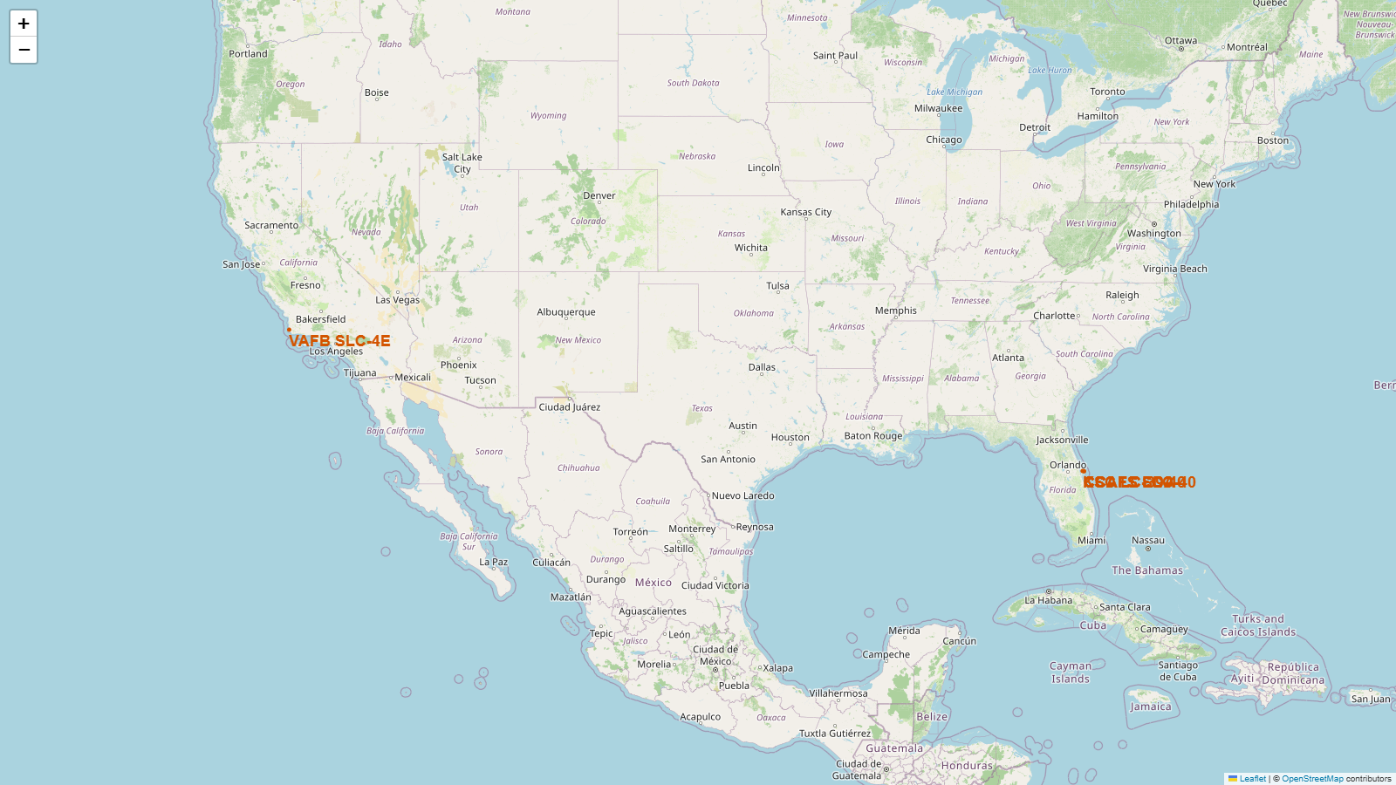
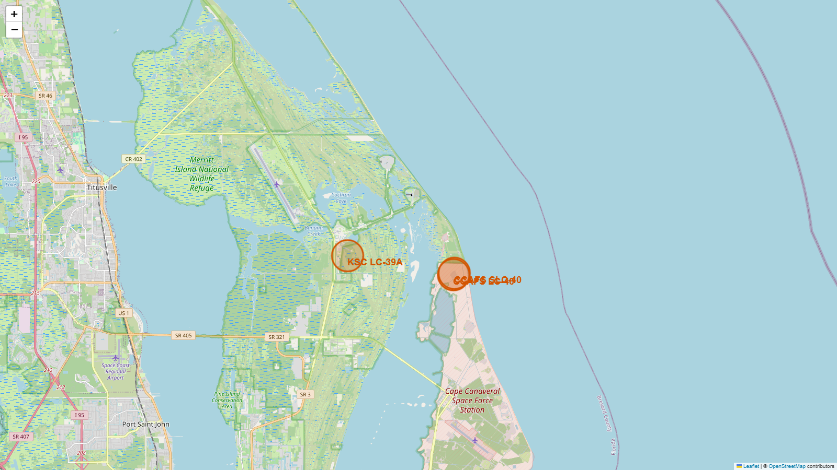
LAUNCH SITES PROXIMITY ANALYSIS
Folium: All Launch Sites on the Map
All sites (USA)
Cape Canaveral close-up (LC-40 and SLC-40 labels overlap: same pad area)
Insight: 3 sites in Florida (CCAFS LC-40, CCAFS SLC-40, KSC LC-39A) and 1 in California (VAFB SLC-4E). All sit on the coast in the south of the USA – closer to the equator gives extra speed from Earth's rotation, and launches fly over the ocean.
GitHub: https://github.com/khoalee252006/spacex-falcon9-capstone/blob/main/notebooks/06_interactive_folium_map.ipynb
25
Notes:
Here are all four launch sites. — Đây là bốn bãi phóng.
They are close to the coast. — Chúng nằm gần bờ biển.
They are also in the south, near the equator. — Chúng cũng ở phía nam, gần xích đạo.

Slide 26
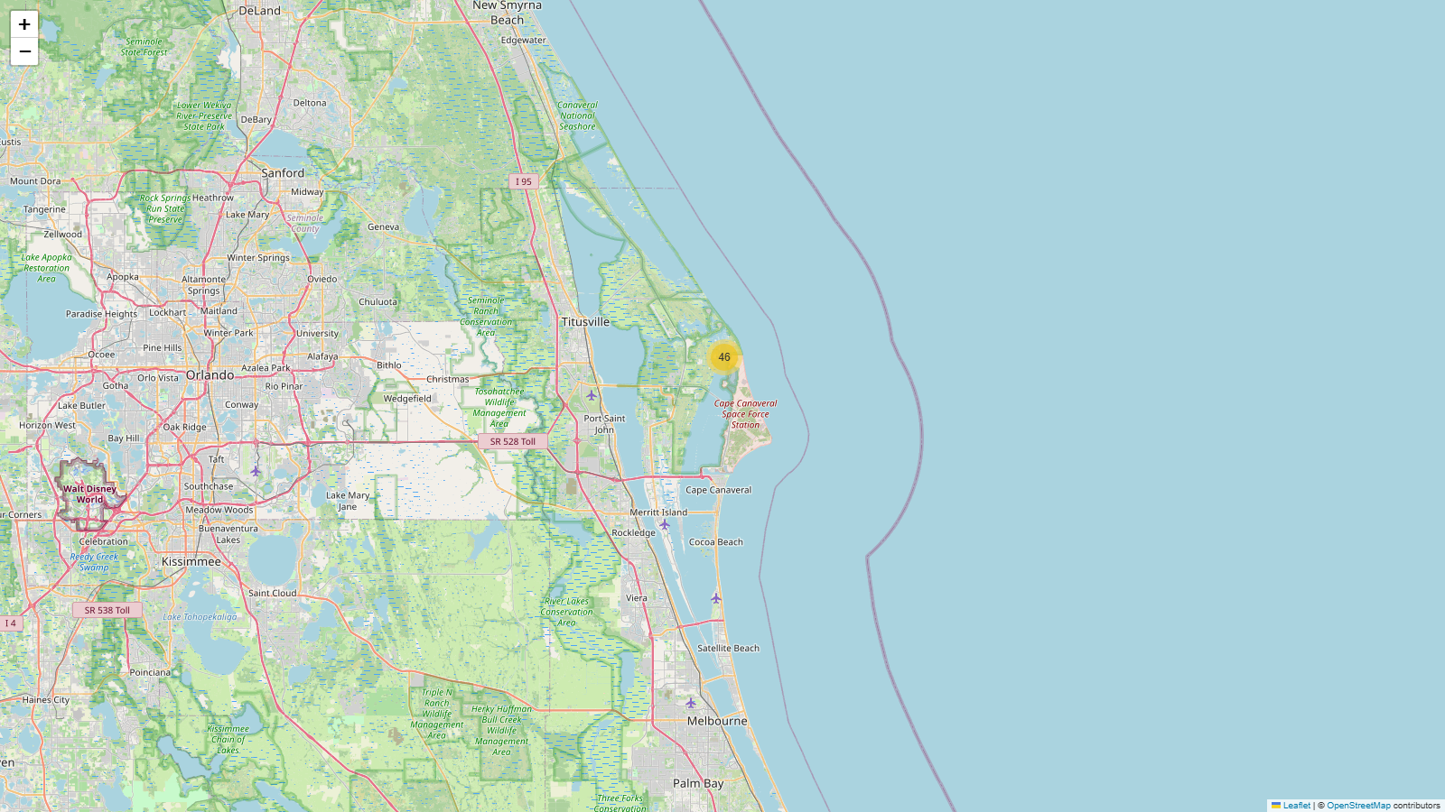
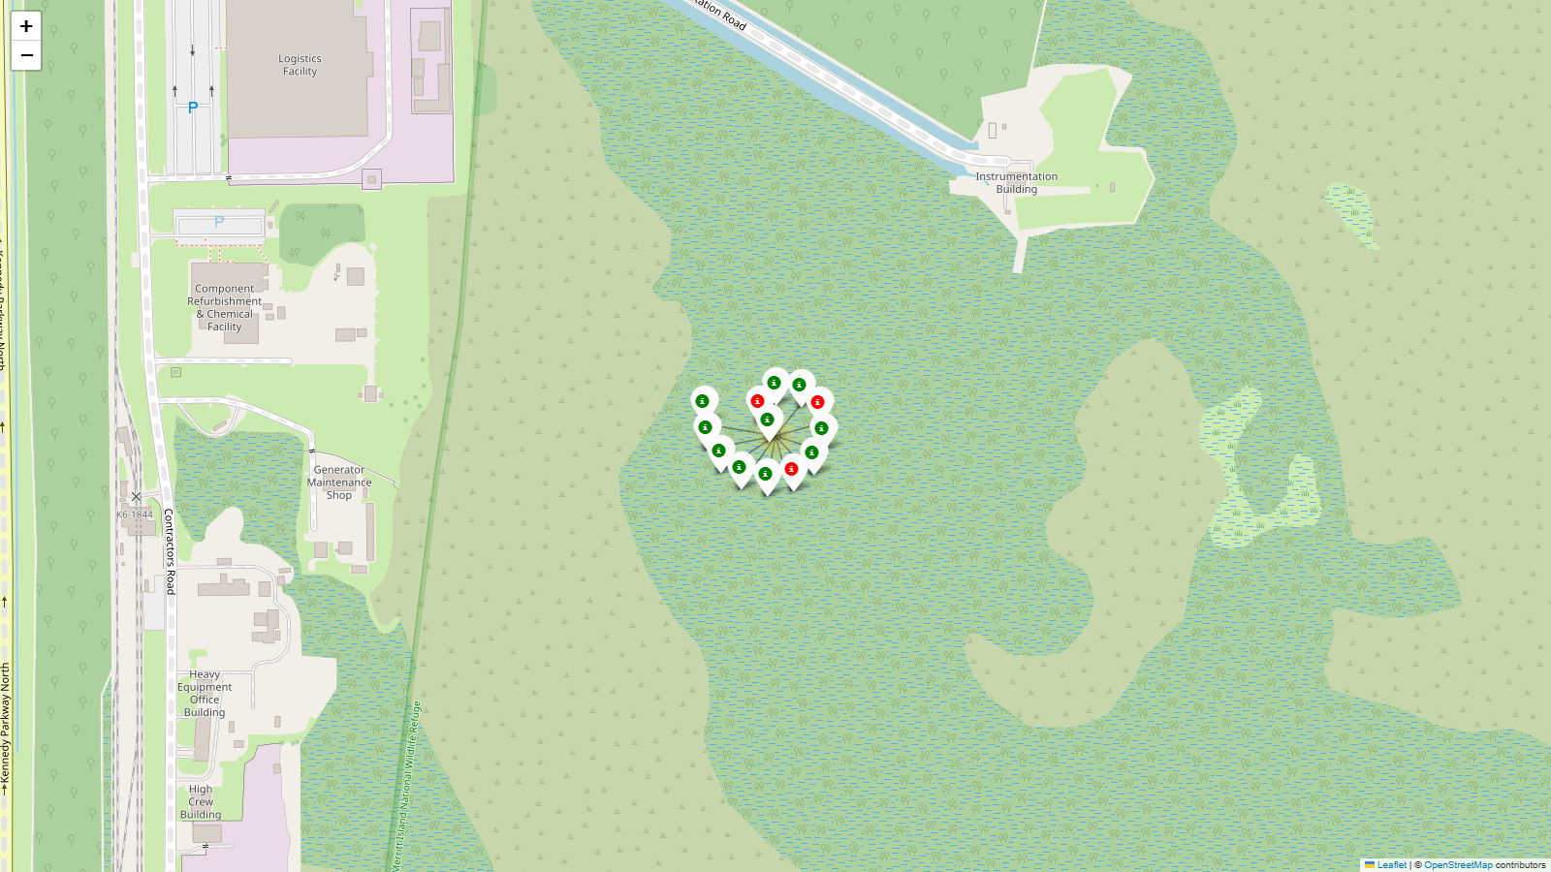
LAUNCH SITES PROXIMITY ANALYSIS
Folium: Launch Outcomes per Site
MarkerCluster – number of launches per site
KSC LC-39A cluster opened – green = landed, red = not landed
Insight: KSC LC-39A: 10/13 landed (77%) | CCAFS SLC-40: 3/7 landed (43%) | VAFB SLC-4E: 4/10 landed (40%) | CCAFS LC-40: 7/26 landed (27%)
GitHub: https://github.com/khoalee252006/spacex-falcon9-capstone/blob/main/notebooks/06_interactive_folium_map.ipynb
26
Notes:
Each marker is one launch. — Mỗi điểm đánh dấu là một lần phóng.
Green means landed and red means not landed. — Xanh nghĩa là hạ cánh, đỏ nghĩa là không hạ cánh.
KSC LC-39A has the most green markers. — KSC LC-39A có nhiều điểm xanh nhất.

Slide 27
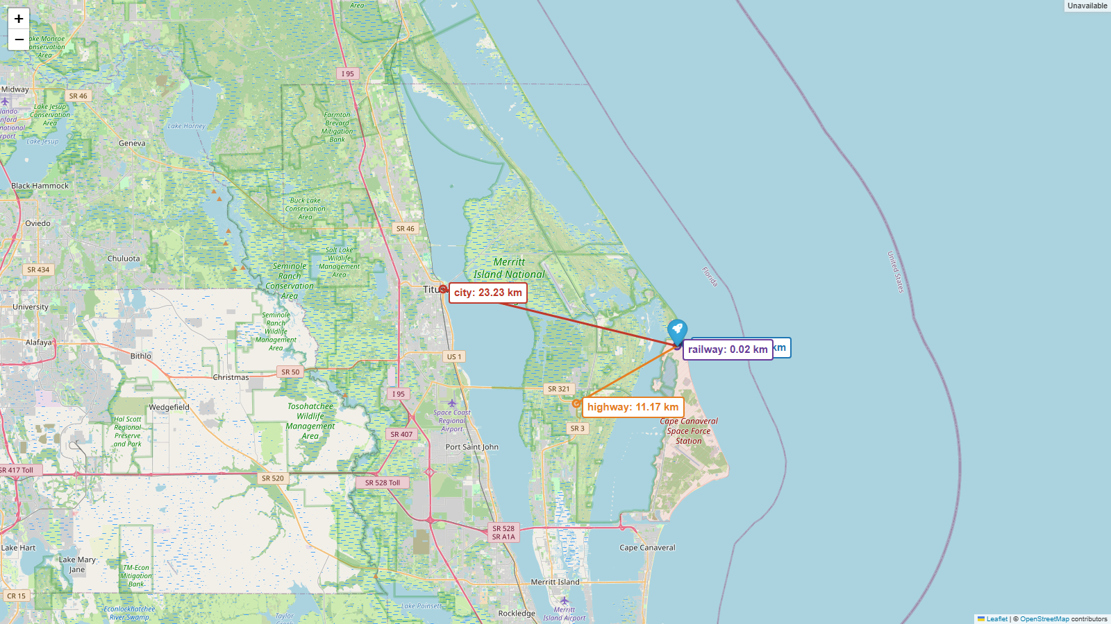
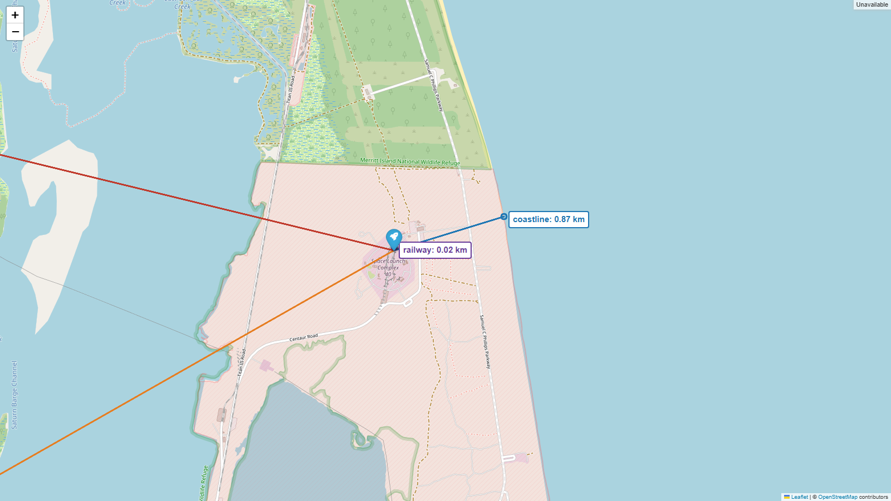
LAUNCH SITES PROXIMITY ANALYSIS
Folium: Proximity Analysis (CCAFS SLC-40)
Overview: highway and city
Close-up: coastline and railway
Nearest | Name (OpenStreetMap) | Distance
Coastline | – | 0.87 km
Railway | – | 0.02 km
Highway | Space Commerce Way | 11.17 km
City | Titusville | 23.23 km
Findings
• Very close to the coast (0.87 km): a failed rocket falls into the ocean
• Very close to a railway (0.02 km): heavy parts arrive by train
• Highway 11.2 km away: road access for people and supplies
• Nearest city (Titusville) 23.2 km away: far from people for safety
GitHub: https://github.com/khoalee252006/spacex-falcon9-capstone/blob/main/notebooks/06_interactive_folium_map.ipynb
27
Notes:
I measure distances from the launch site. — Tôi đo khoảng cách từ bãi phóng.
The coast and railway are very close. — Bờ biển và đường sắt rất gần.
The city is far away for safety. — Thành phố ở xa để đảm bảo an toàn.

Slide 28
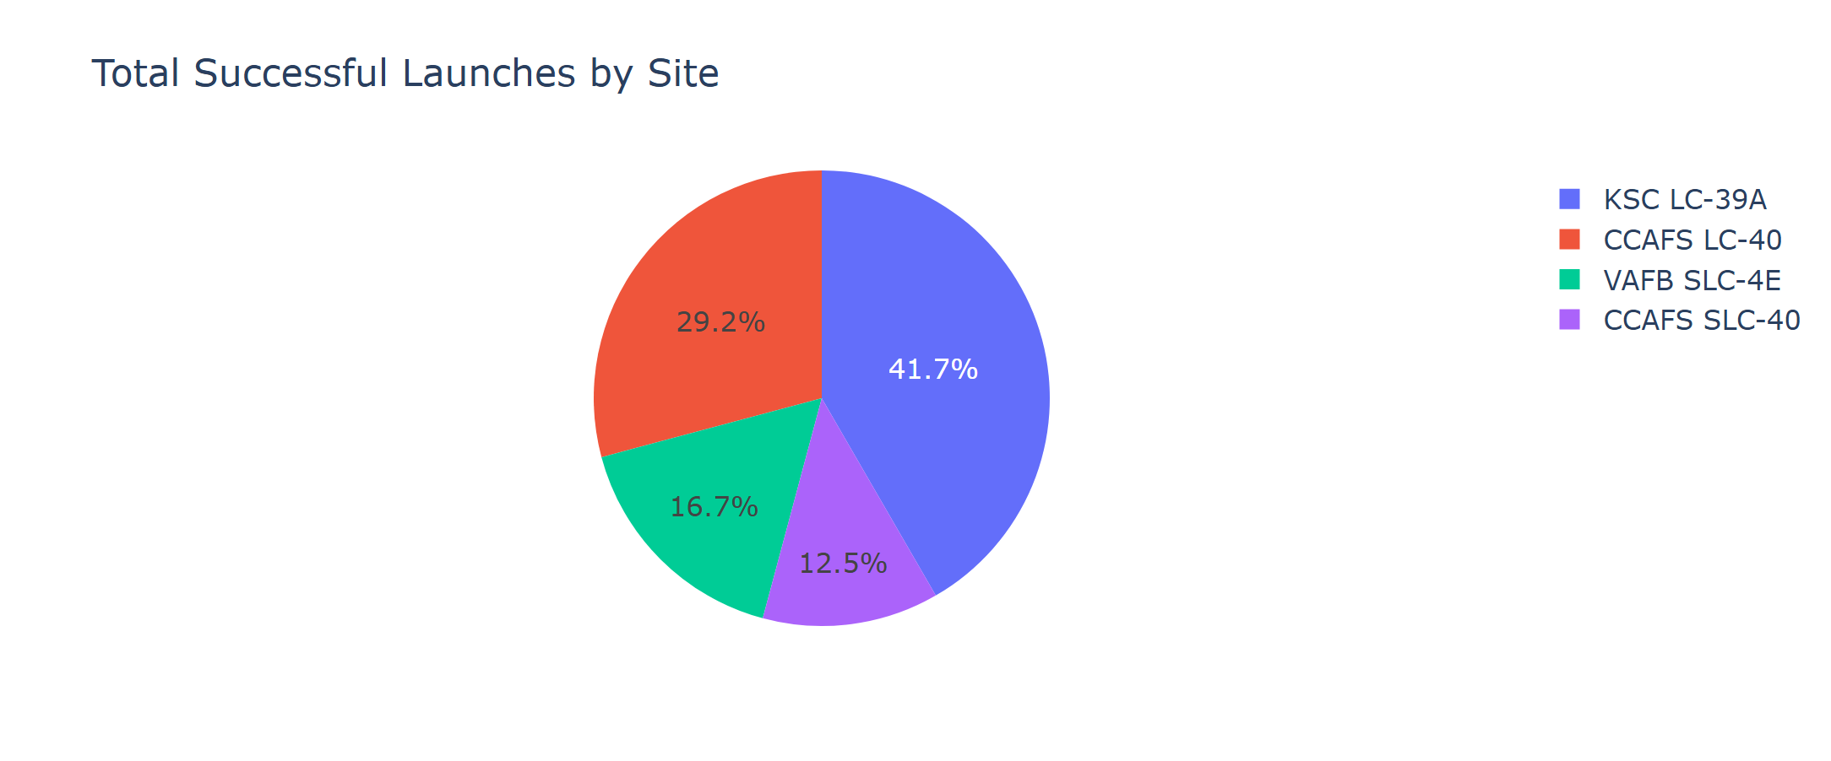
DASHBOARD WITH PLOTLY DASH
Dash: Successful Launches by Site (All Sites)
Launch Site | Successes | Share
KSC LC-39A | 10 | 41.7%
CCAFS LC-40 | 7 | 29.2%
VAFB SLC-4E | 4 | 16.7%
CCAFS SLC-40 | 3 | 12.5%
Insight: KSC LC-39A produced the largest share of all successful launches (41.7%); CCAFS SLC-40 the smallest (12.5%).
GitHub: https://github.com/khoalee252006/spacex-falcon9-capstone/blob/main/notebooks/07_dash_app.py
28
Notes:
This pie shows where the successful launches come from. — Biểu đồ tròn này cho thấy các lần thành công đến từ đâu.
KSC LC-39A has the biggest share. — KSC LC-39A có phần lớn nhất.
CCAFS SLC-40 has the smallest share. — CCAFS SLC-40 có phần nhỏ nhất.

Slide 29
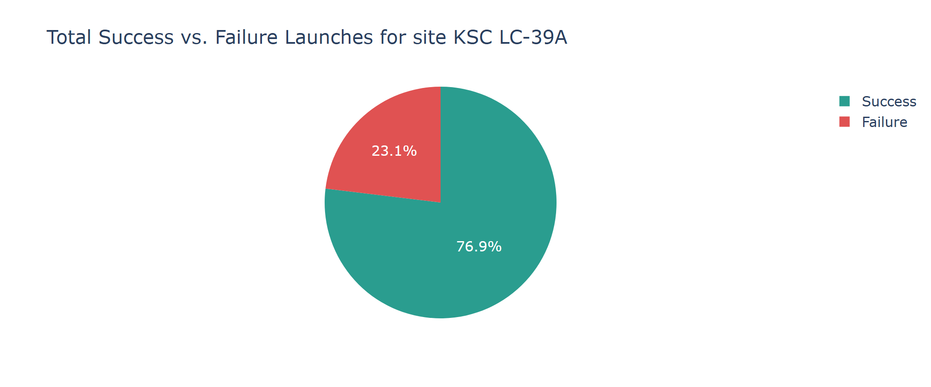
DASHBOARD WITH PLOTLY DASH
Dash: Highest Success Rate Site – KSC LC-39A
Launch Site | Launches | Success rate
KSC LC-39A | 13 | 76.9%
CCAFS SLC-40 | 7 | 42.9%
VAFB SLC-4E | 10 | 40.0%
CCAFS LC-40 | 26 | 26.9%
Insight: KSC LC-39A has the highest success rate: 10 of 13 launches (76.9% success, 23.1% failure).
GitHub: https://github.com/khoalee252006/spacex-falcon9-capstone/blob/main/notebooks/07_dash_app.py
29
Notes:
This pie is only for KSC LC-39A. — Biểu đồ tròn này chỉ dành cho KSC LC-39A.
76.9% of its launches were successful. — 76.9% số lần phóng ở đây thành công.
It is the best site in this data. — Đây là bãi phóng tốt nhất trong dữ liệu này.

Slide 30
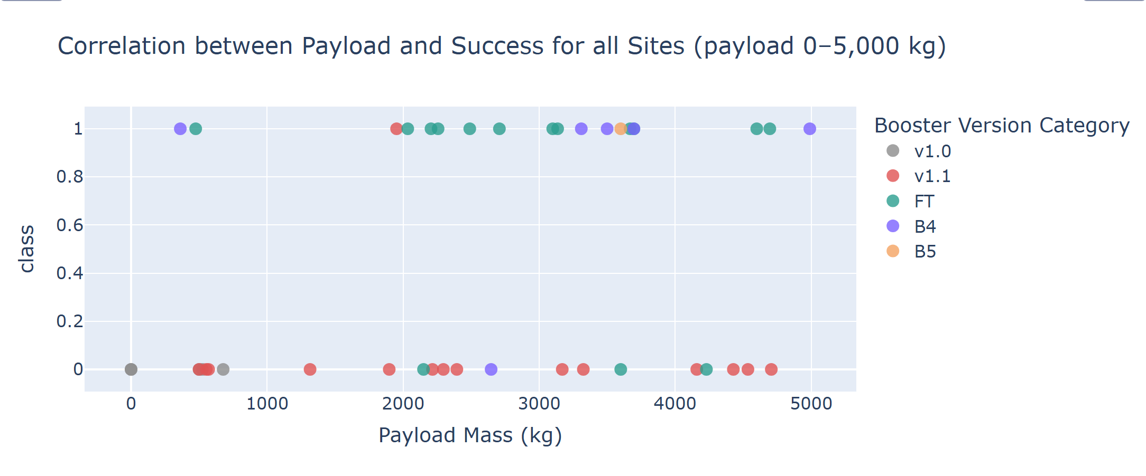
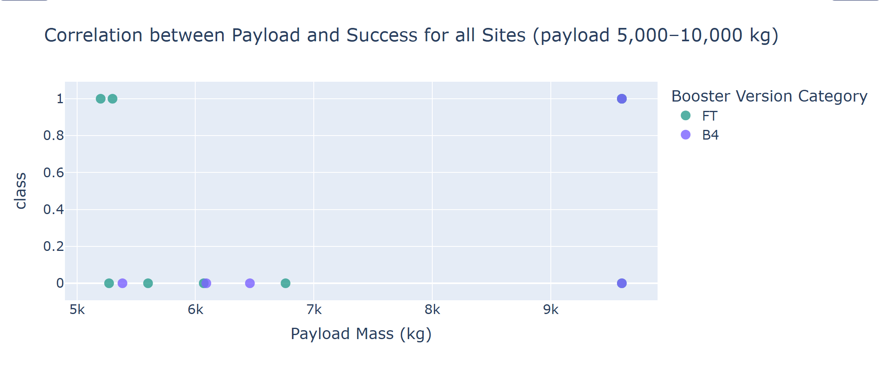
DASHBOARD WITH PLOTLY DASH
Dash: Payload vs. Launch Outcome (All Sites)
Payload (kg) | Launches | Success
0–2,000 | 13 | 23%
2,000–4,000 | 21 | 62%
4,000–6,000 | 13 | 38%
6,000–8,000 | 4 | 0%
8,000–10,000 | 5 | 60%
Booster | Launches | Success
B4 | 11 | 55%
B5 | 1 | 100%
FT | 24 | 67%
v1.0 | 5 | 0%
v1.1 | 15 | 7%
Insight: Best payload range: 2,000–4,000 kg (62%, n = 21); worst: 6,000–8,000 kg (0 of 4). Best booster: FT (67%, n = 24); B5 is 1 of 1 (too few); v1.1 lowest (7%).
GitHub: https://github.com/khoalee252006/spacex-falcon9-capstone/blob/main/notebooks/07_dash_app.py
30
Notes:
These charts show payload and outcome together. — Các biểu đồ này cho thấy tải trọng và kết quả cùng nhau.
Light and medium payloads succeed more often. — Tải nhẹ và trung bình thành công thường xuyên hơn.
The FT booster version has the best success rate. — Phiên bản tầng đẩy FT có tỉ lệ thành công tốt nhất.

Slide 31
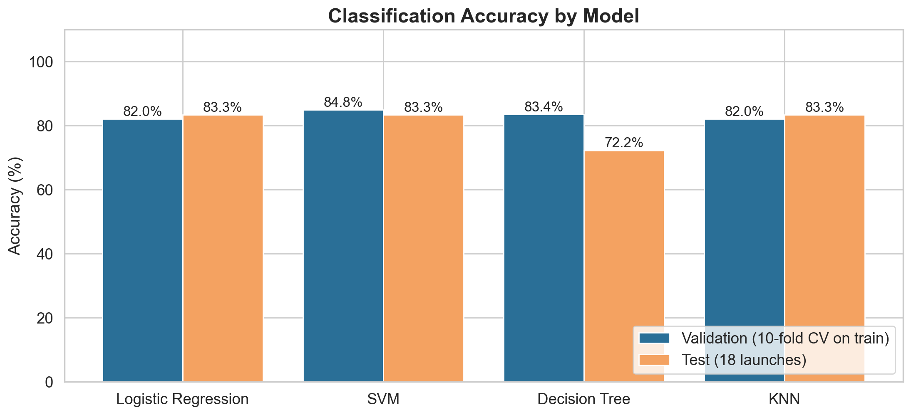
PREDICTIVE ANALYSIS (CLASSIFICATION)
Classification Accuracy
Model | Validation | Test | 10-fold CV (all 90)
Logistic Regression | 82.0% | 83.3% | 83.3% ± 12.4
SVM | 84.8% | 83.3% | 84.4% ± 10.2
Decision Tree | 83.4% | 72.2% | 78.9% ± 13.6
KNN | 82.0% | 83.3% | 81.1% ± 8.7
Model | Best parameters (GridSearchCV)
Logistic Regression | C: 0.1, solver: lbfgs
SVM | C: 1, gamma: 0.0316, kernel: sigmoid
Decision Tree | criterion: gini, max_depth: 10, max_features: sqrt, min_samples_leaf: 1, min_samples_split: 2, splitter: random
KNN | algorithm: auto, n_neighbors: 7, p: 1
GitHub: https://github.com/khoalee252006/spacex-falcon9-capstone/blob/main/notebooks/08_predictive_analysis.ipynb
31
Notes:
I tested four models. — Tôi đã thử bốn mô hình.
Three models tie at 83.3% on the test set. — Ba mô hình hoà nhau ở mức 83.3% trên tập kiểm tra.
SVM has the best validation score. — SVM có điểm kiểm định tốt nhất.
The decision tree is the weakest on the test set. — Cây quyết định yếu nhất trên tập kiểm tra.

Slide 32
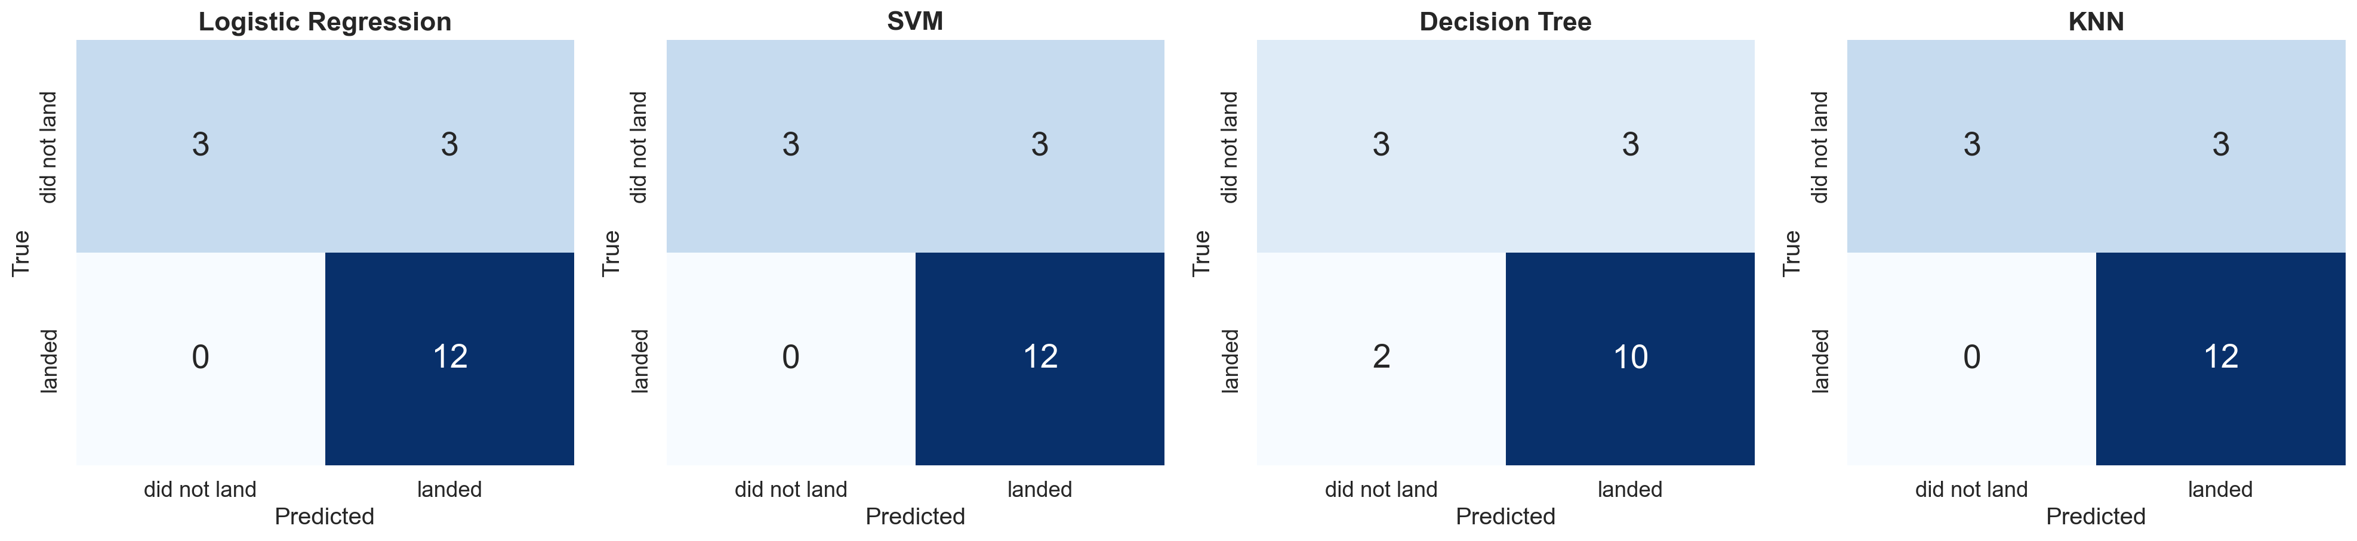
PREDICTIVE ANALYSIS (CLASSIFICATION)
Confusion Matrix
LR, SVM and KNN: same matrix – TP = 12, TN = 3, FP = 3, FN = 0. Every landed booster is found (recall = 100%), but 3 of 6 non-landings are wrongly predicted as landed.
Decision Tree: TP = 10, TN = 3, FP = 3, FN = 2 – it also misses 2 real landings.
Insight: The main error is the false positive: the models are too optimistic about landing. For cost estimates this is the risky mistake (a bid would assume a reusable booster).
GitHub: https://github.com/khoalee252006/spacex-falcon9-capstone/blob/main/notebooks/08_predictive_analysis.ipynb
32
Notes:
The test set has 18 launches. — Tập kiểm tra có 18 lần phóng.
All landed boosters are predicted correctly by three models. — Ba mô hình dự đoán đúng tất cả tầng đẩy đã hạ cánh.
The problem is false positives. — Vấn đề là dương tính giả.
Some failed landings are predicted as landed. — Một số lần hạ cánh thất bại bị dự đoán là đã hạ cánh.

Slide 33
PREDICTIVE ANALYSIS (CLASSIFICATION)
Best Model
Selected model
Support Vector Machine
Kernel: sigmoid, C = 1, gamma = 0.032
Validation accuracy: 84.8% (best of 4)
Test accuracy: 83.3% (tied best)
10-fold CV on all data: 84.4% (best of 4)
Why SVM – and an honest warning
• Logistic Regression, SVM, KNN all score 83.3% on the test set: the same 15 of 18 correct.
• With only 18 test launches, one prediction = 5.6 points, so the test set cannot separate these models.
• SVM is highest on both validation (84.8%) and 10-fold CV on all 90 launches (84.4%).
• But the CV spread is about ±10 points, so the gap to Logistic Regression (83.3%) is small.
• Logistic Regression is a good simpler alternative.
GitHub: https://github.com/khoalee252006/spacex-falcon9-capstone/blob/main/notebooks/08_predictive_analysis.ipynb
33
Notes:
On the test set, three models are equal. — Trên tập kiểm tra, ba mô hình bằng nhau.
The test set is small, so this tie is not surprising. — Tập kiểm tra nhỏ nên việc hoà không có gì lạ.
SVM is a little better in cross validation. — SVM tốt hơn một chút khi kiểm định chéo.
So I choose SVM, but the difference is small. — Vì vậy tôi chọn SVM, nhưng khác biệt là nhỏ.

Slide 34
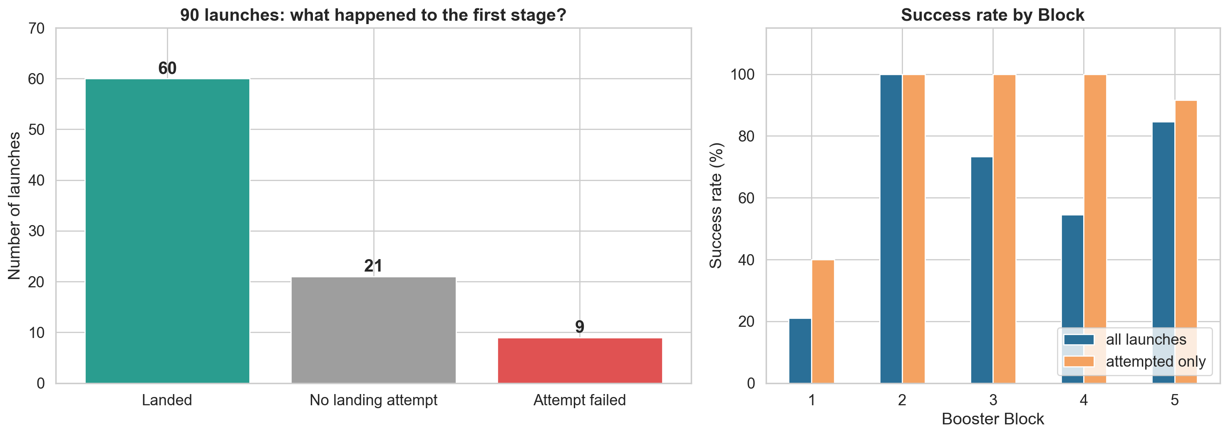
PREDICTIVE ANALYSIS (CLASSIFICATION)
What Really Drives Landing Success?
Class = 0: 30 launches
• No landing attempt: 21
• Attempt failed: 9
Attempted landings: 60 of 69 succeeded (87.0%)
Attempted, by Block: 1 = 40%, 2–4 = 100%, 5 = 92%
Reused booster: 78% vs. new: 58%
Insight: Most 'failures' are planned: 21 of 30 Class-0 launches had no landing attempt (12 of them GTO). Once SpaceX tries, it lands 87% of the time – so predicting the mission plan (orbit, payload) matters more than the landing itself.
GitHub: https://github.com/khoalee252006/spacex-falcon9-capstone/blob/main/notebooks/08_predictive_analysis.ipynb
34
Notes:
21 of the 30 failures were not real failures. — 21 trong 30 lần thất bại không phải thất bại thật.
SpaceX did not even try to land. — SpaceX thậm chí không thử hạ cánh.
When they tried, 87% landed. — Khi họ thử, 87% đã hạ cánh.
So the key question is: will they try to land? — Vậy câu hỏi chính là: họ có thử hạ cánh không?

Slide 35
Conclusion
• Experience matters: success rose from 0% (2010–2013) to 90% (2019); flights 61–90 land 83% vs. 43% for flights 1–30.
• Orbit matters: VLEO 86%, ISS 62%, GTO only 52% (heavy GTO payloads are hardest).
• Launch sites are all next to the coast, near rail, and far from cities; KSC LC-39A has the best success rate in the dashboard data (77%).
• Payloads of 2,000–4,000 kg and FT boosters show the best success in the dashboard data.
• LR, SVM and KNN reach 83.3% test accuracy; SVM is chosen (best validation / CV), but the small test set means the models are nearly equal.
Creative insight
"Failure" is mostly a choice. 21 of 30 non-landings had no landing attempt; 12 of them were GTO missions.
This also explains the 2018 dip: 6 launches that year did not try to land.
When SpaceX tries, it lands 87% of the time.
Advice for Space Y: price a bid in two steps – (1) will SpaceX try to land for this orbit and payload? (2) if yes, expect the booster to be reused.
GitHub: https://github.com/khoalee252006/spacex-falcon9-capstone
35
Notes:
SpaceX improved very fast over the years. — SpaceX tiến bộ rất nhanh qua các năm.
Orbit, payload and experience affect landing. — Quỹ đạo, tải trọng và kinh nghiệm ảnh hưởng đến hạ cánh.
Our models predict landing with about eighty-three percent accuracy. — Mô hình của chúng tôi dự đoán hạ cánh với độ chính xác khoảng tám mươi ba phần trăm.
My advice: first predict if SpaceX will try to land. — Lời khuyên của tôi: hãy dự đoán trước SpaceX có thử hạ cánh không.

Slide 36
Appendix: Data Sources and Notes
• SpaceX REST API v4 (api.spacexdata.com) – live server returned HTTP 522/525 in Oct 2026; used IBM static copy of /launches/past and archived API responses from web.archive.org (rockets, payloads, launchpads, cores).
• Validation: our dataset_part_1.csv matches IBM's reference in 15 of 17 columns; small differences in PayloadMass and ReusedCount come from a newer API snapshot.
• Wikipedia: List of Falcon 9 and Falcon Heavy launches, revision oldid = 1027686922.
• IBM course files: Spacex.csv (SQL), spacex_launch_geo.csv (Folium), spacex_launch_dash.csv (Dash).
• OpenStreetMap via Overpass API for nearest coastline, railway, highway and city (© OpenStreetMap contributors, ODbL). Note: the course file places KSC LC-39A slightly inland, so we show proximity for CCAFS SLC-40.
• Tools: Python 3.12, pandas, numpy, requests, BeautifulSoup, matplotlib, seaborn, sqlite3, folium, plotly / Dash, scikit-learn, Playwright (screenshots).
• Maps (interactive HTML): images/folium_1_launch_sites.html, folium_2_launch_outcomes.html, folium_3_proximity.html
GitHub: https://github.com/khoalee252006/spacex-falcon9-capstone
36
Notes:
This slide lists my data sources. — Slide này liệt kê các nguồn dữ liệu của tôi.
The SpaceX API was down, so I used saved copies of the same data. — SpaceX API bị lỗi nên tôi dùng bản lưu của cùng dữ liệu đó.
Everything is in the GitHub repository. — Mọi thứ đều có trong kho GitHub.

